Slide 1
One-sample mean with the t-distribution

Slide 2
Number of college applications
A similar survey asked how many colleges students applied to, and 206 Duke students responded to this question. This sample yielded an average of 9.7 college applications, with a standard deviation of 5.9. College Board website states that counselors recommend students apply to roughly 8 colleges.
Do the survey data provide convincing evidence that the average number of colleges all Duke students apply to is higher than recommended?

Slide 3
Setting the hypotheses
We start with the assumption the average number of colleges Duke students apply to is 8 (as recommended)
H₀ : 𝝁 = 8
We test the claim that the average number of colleges Duke students apply to is higher than 8
H_{A} : 𝝁 > 8

Slide 4
Check conditions
Independence?
Sample size (n≥30) or Normality?

Slide 5
The normality condition
The CLT, which states that sampling distributions will be nearly normal, hold true for any sample size as long as the population distribution is nearly normal
We should exercise caution when verifying the normality condition for small samples. It is important to not only examine the data but also think about where the data come from
For example, ask: would I expect this distribution to be symmetric, and am I confident that outliers are rare?

Slide 6
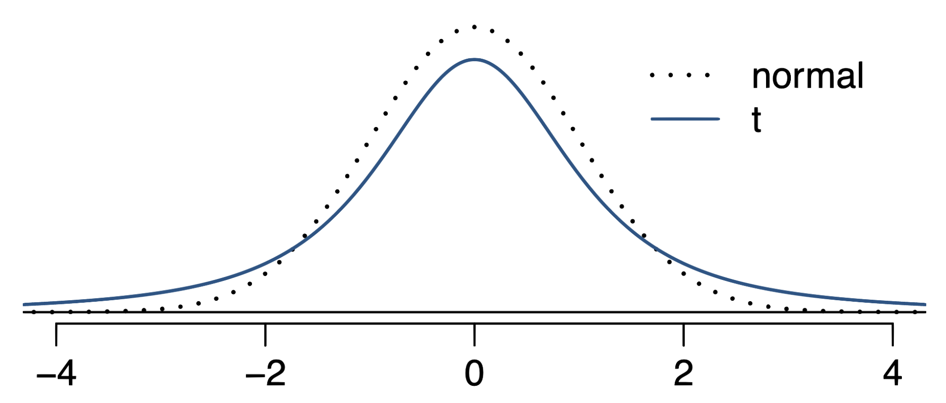
The 𝒕 distribution
When the population standard deviation σ is unknown (almost always), the uncertainty of the SE estimate is addressed by using a new distribution: the 𝒕 distribution.
This t distribution also has a bell shape, but it’s flatter than the standard normal curve.

Slide 7
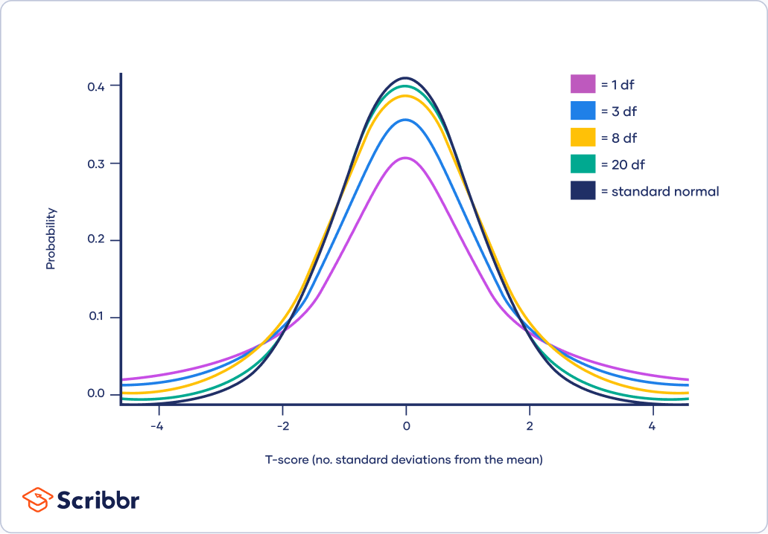
The 𝒕 distribution (cont.)
Always centered at zero, like the standard normal (𝓏) distribution
Has a single parameter: degrees of freedom (df).

Slide 8
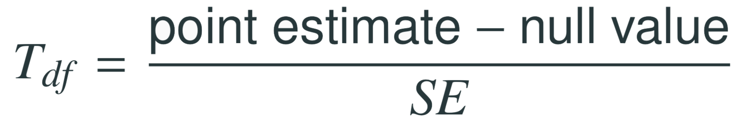
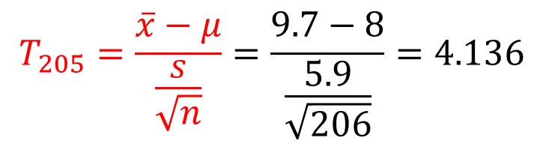
Find the test statistic
This 𝑇 test statistic has df = n – 1.
$$T_{205}=\frac{\overline{x}−μ}{\frac{s}{\sqrt{n}}}=\frac{9.7−8}{\frac{5.9}{\sqrt{206}}}=4.136$$

Slide 9
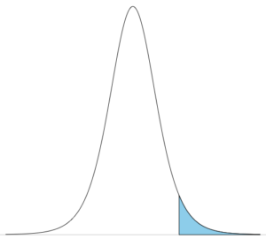

Finding the p-value
The p-value is, once again, calculated as the area under the tail of the 𝒕 distribution
4.136

Slide 10
Conclusion of the test
What is the conclusion of this hypothesis test?
Since the p-value is lower than α which is 0.05 by default, we reject Ho. So the survey data provide strong evidence that Duke students apply to more than 8 schools on average.

Slide 11
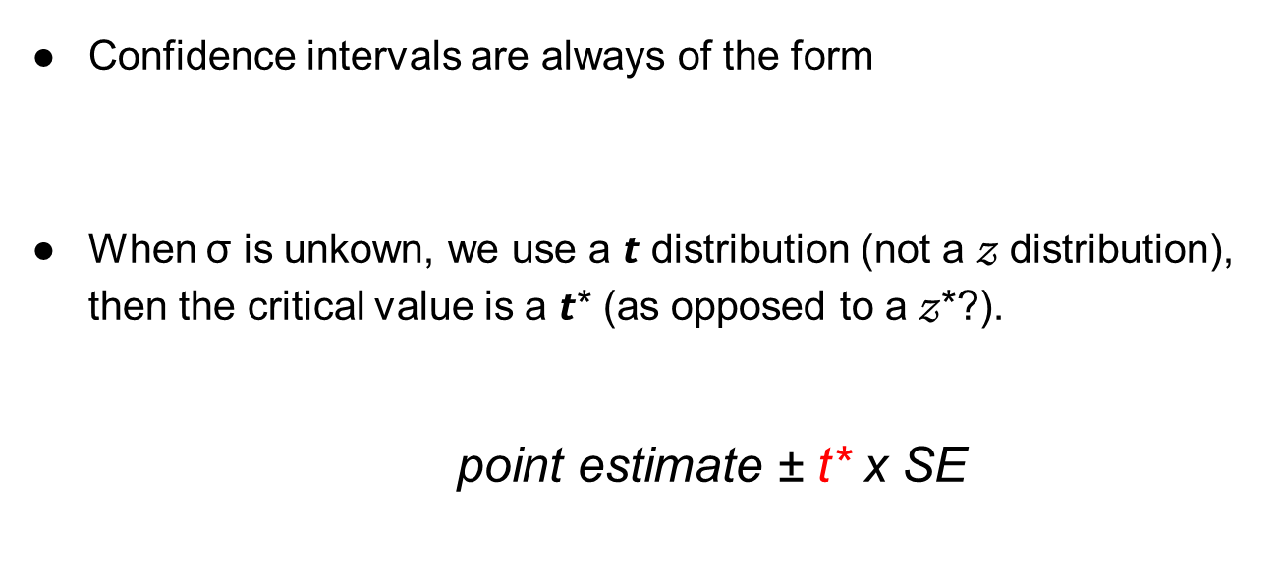
Confidence interval for mean
Confidence intervals are always of the form
When σ is unkown, we use a 𝙩 distribution (not a 𝓏 distribution), then the critical value is a 𝙩* (as opposed to a 𝓏*?).
$\text{point} \text{estimate}\text{ ± }\text{t}\text{*} \text{x} \text{SE}$
point estimate ± z* x SE
Using R:
left-tail
> qt(0.975, df = 205)
[1] 1.971603

Slide 12
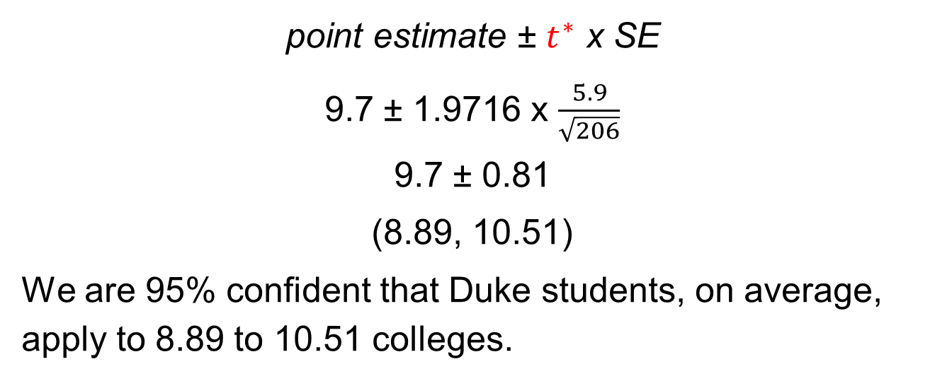
Constructing a CI for a small sample mean
What is a 95% confidence interval for the average number of colleges that Duke students apply to?
$$\text{point} \text{estimate}\text{ ± }t^{∗} \text{x} \text{SE}$$
9.7 ± 1.9716 x $\frac{5.9}{\sqrt{206}}$
9.7 ± 0.81
(8.89, 10.51)
We are 95% confident that Duke students, on average, apply to 8.89 to 10.51 colleges.

Slide 13



Recap: Inference using the 𝒕-distribution
If 𝞼 is unknown, use the 𝒕-distribution with
Hypothesis Testing:
Confidence interval:

